Slide 1
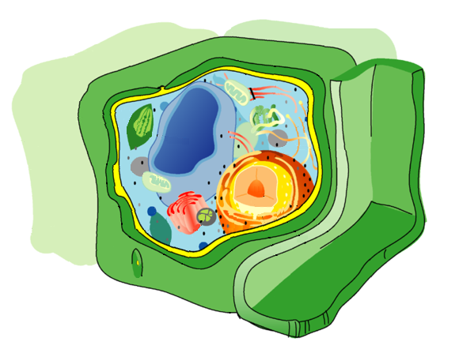
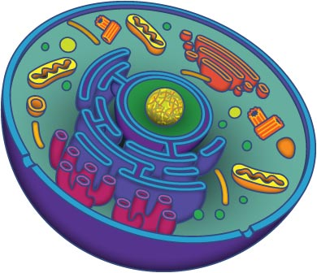
Cell Bingo

Slide 2
Create your bingo card
Mitochondria
Chloroplast
Cell Membrane
Tissue
Unicellular
Nucleus
Vacuole
Organelle
Endoplasmic Reticulum
Golgi Apparatus
Cell Wall
Organ
Cell
Nuclear Membrane
Robert Hooke
Cell Theory
Microscope
Cytoplasm
Prokaryotic
Ribosome
Organ System
Multicellular
Eukaryotic
Organism
Nucleolus
Centriole
Lysosome

Slide 3
Controls what goes in and out of the cell
Found in both plant cells and animal cells

Slide 4
Scientist who looked at cork under a microscope and named “cells”

Slide 5
Helps protect and provide shape of plant cells

Slide 6
Directs cellular activity

Slide 7
Jelly-like substance found inside all cells

Slide 8
Produces proteins for the cell

Slide 9
Transports proteins and other materials throughout the cell

Slide 10
Known as the powerhouse of the cell

Slide 11
Sorts and packages proteins and other cellular materials

Slide 12
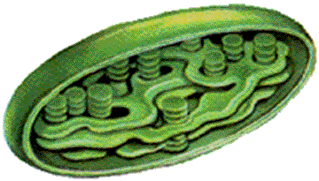
Photosynthesis occurs here

Slide 13
Found inside the nucleus
Creates ribosomes

Slide 14
Animal cells have multiple small ones
Plant cells have one large one

Slide 15
Breaks down and recycles waste and old cell parts

Slide 16
Surrounds and protects the nucleus

Slide 17
Small, specialized units that work together inside a cell

Slide 18
An organism made up of only one cell

Slide 19
Smallest and most basic unit of life

Slide 20
An organism made up of two or more cells

Slide 21
Two or more cells working together to perform a specific job

Slide 22
Type of cell without a nucleus
Ex: bacteria

Slide 23
Two or more tissues working together to perform a specific function

Slide 24
Type of cell with a nucleus
Ex: plant and animal

Slide 25
Any living thing
Carries out all basic functions of life

Slide 26
Organizes the movement of chromosomes during cell division

Slide 27
Instrument used to see things that are not visible to the “naked” eye

Slide 28
Two or more organs working together

Slide 29
1. All living things are made up cells
2. Cells are basic unit of structure and function
3. Cells come from existing cells

