Slide 1
Choose a Title for the results of your team’s scavenger hunt and place it on the first slide...
with all of your first names, last initials.

Slide 2
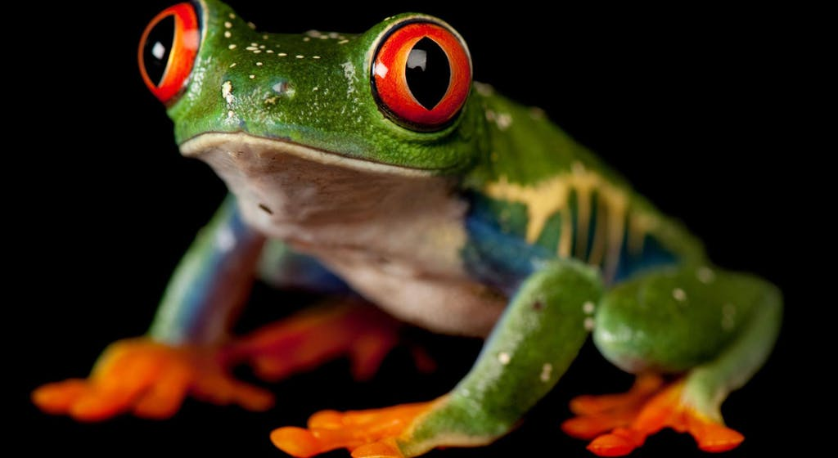
Post a picture your team took of an organism and...
Insert a text box over the picture giving the common name and the scientific name.
Later, we will add the NICHE of your organism to the top.
Insert a text box over the picture giving the common name and the scientific name.
Later, we will add the NICHE of your organism to the top.

Slide 3
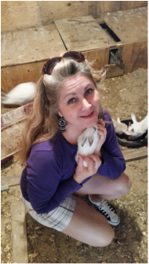
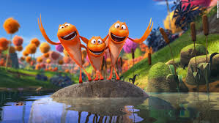
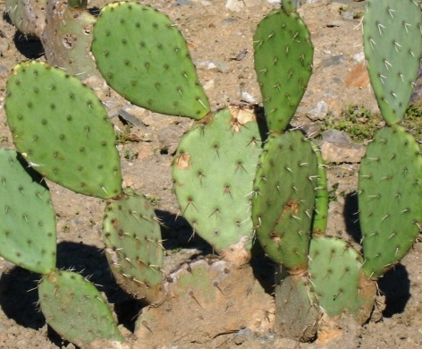
Keep adding a new slide for each picture you have. Work as a team and identify as many of your pictures as you can before our deadline!

